Slide 1

Midwest Regional Rocket Launch Competition Overview of the Design to Flight Process

Slide 2
Design Goals
The goals of the project are as follows:
Design, build and fly a rocket to 3000 feet
Motor used will be a Cesaroni I540 (~635 nt-secs)
Maximum body tube diameter – 4 inches
Maximum length – 72 inches
Maximum weight (without motor) – 7.5 lbs
Use an altimeter for electronic apogee deployment
Carry an additional altimeter to record the altitude for the competition

Slide 3
Design Goals
To give you some idea of what this means consider that the AE 100 class rockets were 3 inches in diameter, around 6 feet long, weighed around 6 lbs. (including the motor) and flew to around 4000 feet on very slightly larger (5 or 6 percent larger) J350 motors with approximately 670 nt-secs of total impulse.

Slide 4
Process Stages
Design and Simulate the Rocket
Preliminary Design Review
Scale Model Construction and Flight (optional)
Budget and Final Design Review
Construction
Ground Testing
Safety Check
Flight Testing
Contest Flight

Slide 5
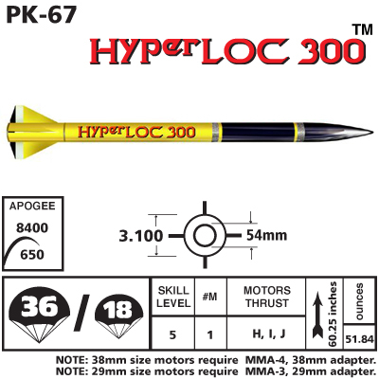
Design The Rocket
Start with an initial design. Perhaps from a kit.

Slide 6
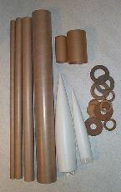
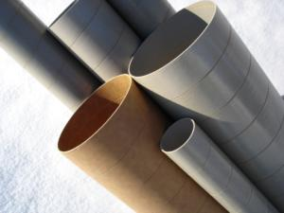
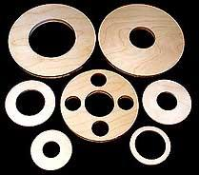
Design The Rocket
You could also create a design from scratch using parts available from vendors.

Slide 7
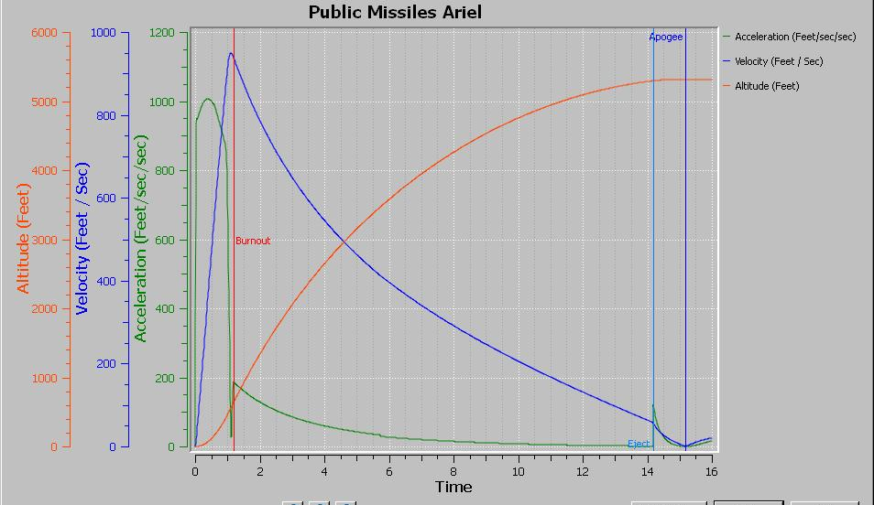
Design The Rocket
Simulate the rocket’s flight.

Slide 8
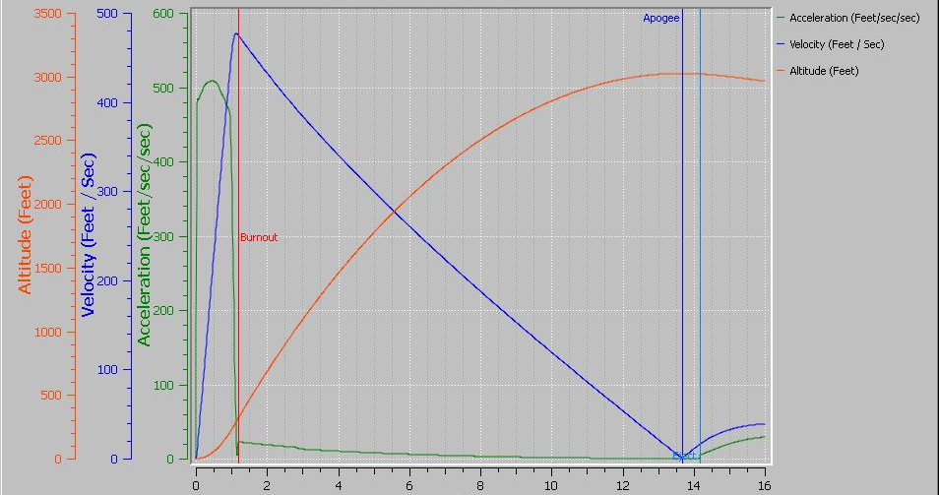
Design The Rocket
Modify the design based on the results. Lather, rinse and repeat, until your goals are achieved.

Slide 9
Preliminary Design Review
We’ll want to check your design to make sure it makes sense and that you are on the right track.
Does the design achieve the project goals?
Does the rocket appear to be stable?
Will the design be reasonable to build (i.e. not too difficult)?
Have safety concerns been taken into account?

Slide 10
Scale Model Flight
If time allows you may want to build and fly a scale model of your design. This could be especially important if your design is very complex or non-traditional. This would be a proof-of-concept for the design.
Modifications to the design can then be made based on the results of the flight.

Slide 11
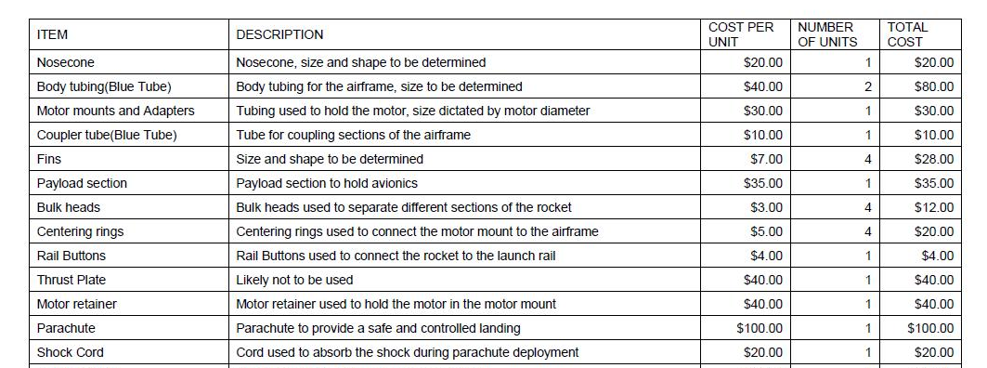
Develop a Budget for the Project
Create a list of everything you will need and what it will cost. Include some amount for miscellaneous costs that you can’t foresee.

Slide 12
Budget Review
We’ll look over your budget to see that you have included all the things you will need and have made good choices.
We may suggest some additional items you haven’t thought of or some substitutions we feel will work better for your design.

Slide 13
Construction
Now you need to actually build your rocket. This requires a fair amount of time and needs a space where the rocket can be safely left while the epoxy cures.
You may be able to share space with the other teams. Also there may be tools and other supplies that can be shared.

Slide 14
Construction
Once you have the parts you can enter their actual mass and dimensions into your simulation to get a more accurate idea of how the design will perform. As the inevitable changes are made to the design during construction you can continue to update the simulation.

Slide 15
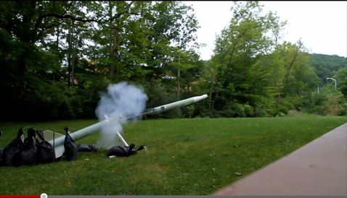
Ground Testing
Several things should be tested on the ground. These include the electronics and deployment.

Slide 16
Safety Checks
We will want to do a thorough safety check of your rocket prior to its first flight. However, we will also want to check on your progress as you build the rocket. It is usually easier to correct problems if they are discovered during construction, rather than after the rocket is finished.

Slide 17
Safety Checks
Some of the elements we will be checking are:
Adequate glue joints and fillets
Secure attachment of motor retention hardware
Strong and secure recovery system attachment points
The relative position of CG and CP

Slide 18
Test Flights
These can be done on smaller motors and in a smaller field than the final contest flight. This allows you to do more flights at a lower cost.
Through test flights you will learn how to prep and fly your rocket and discover any problems so they can be fixed. The data from these flights can be used to improve your simulation and thus do a better job of predicting your final contest flight.

Slide 19
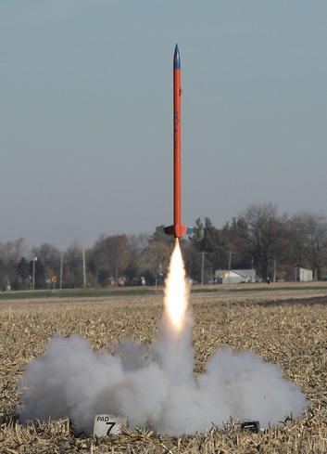
Contest Flight
Now you should be confident that your rocket will perform the way you want it to and will achieve the goals of the competition.

